Slide 1
CTF model for long reverberation Date：2022. 03. 22
Telecom Electroacoustics Audio(TEA) Lab
Presenter:
Anchi Yuan
Notes:
Hello everyone
I’m today’s presenter siang. I’m going to share some of my present work in source separation problem. My topic is comparative studies of source separation using semi-blind and blind source separation approaches.

Slide 2
Outline
Recursive estimation of CTF
Simulation settings
ATF estimation
Future work

Slide 3
Recursive estimation of CTF

Slide 4
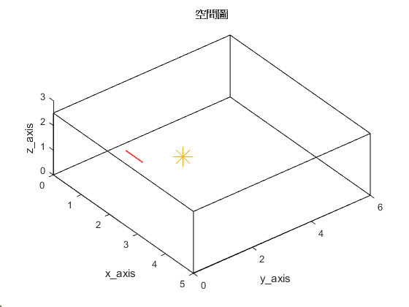
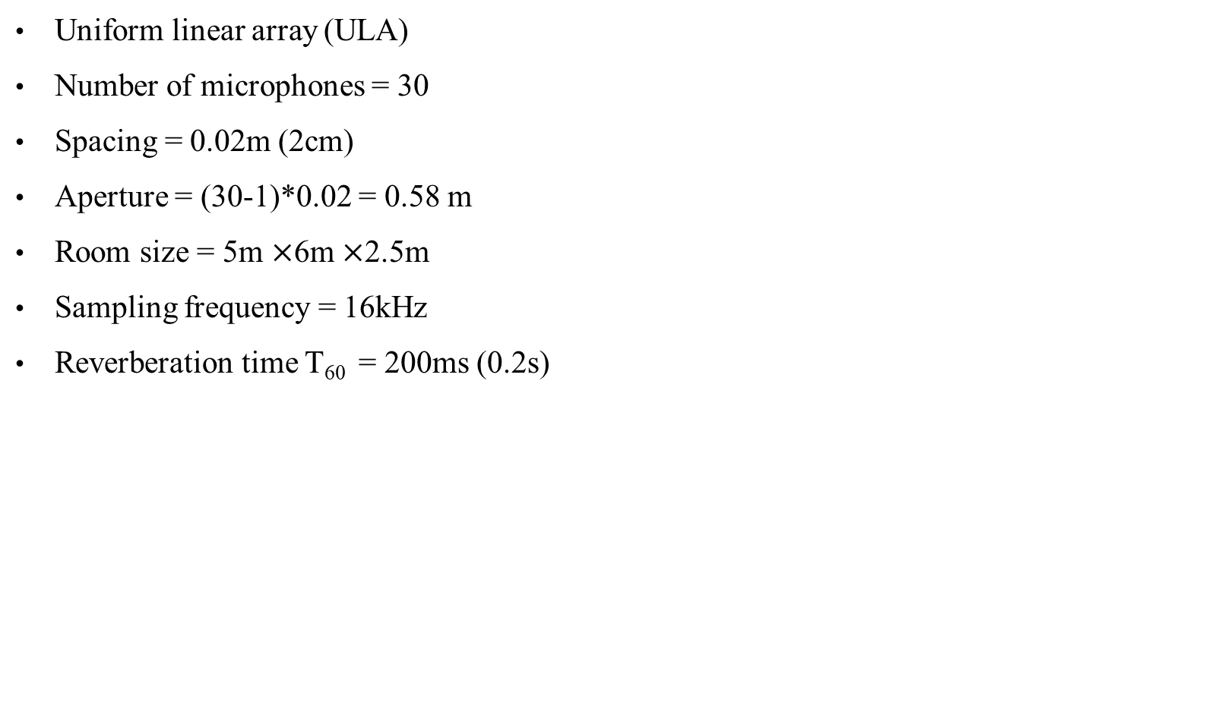
Simulation settings
Uniform linear array (ULA)
Number of microphones = 30
Spacing = 0.02m (2cm)
Aperture = (30-1)*0.02 = 0.58 m
Room size = 5m $×$6m $×$2.5m
Sampling frequency = 16kHz
Reverberation time T₆₀ = 200ms (0.2s)
First microphone location [1, 1.5, 1]
2.5m
origin
Source location [2, 2.6, 1]
5m
6m

Slide 5
ATF estimation (1)
Ground-truth RIR

Slide 6
ATF estimation (2)
R_{ss} R_{sy} initialize with ground-truth source
R_{ss} R_{sy} initialize with recursive ATF (DAS)

Slide 7
Future work
Generates .wav for source predictions
Blind system ID → Benesty’s approaches

Slide 8


Slide 9


Source predictions
Ground-truth source | Microphone received
R_{ss} R_{sy} initialize with ground-truth source | R_{ss} R_{sy} initialize with recursive ATF (DAS)

